Slide 1

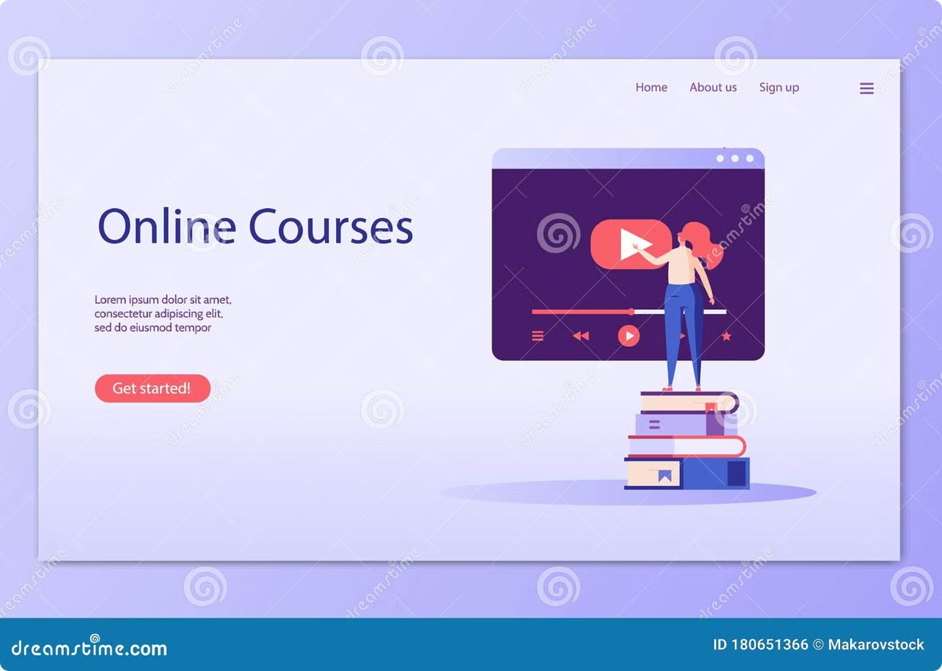
Dana-Bilim AI: Personalized learning with AI
Welcome to the launch of Dana-Bilim AI, an educational platform that uses artificial intelligence to personalize programming and English language learning for students in grades 5-11 in Kazakhstan.
By Batyrbek Raiymbek & Begali Dinmukhammed

Slide 2


Elevator Pitch
Dana-Bilim AI — is an educational platform that personalizes programming and English language learning for students in grades 5-11 in Kazakhstan using AI. Unlike traditional courses, we offer a solution that allows students to learn according to their individual abilities and pace.
Personalization
Instruction is customized to meet the individual needs of each student.
Artificial intelligence
AI analyzes the training data and selects the best approach.
Programming and English
The platform offers courses in these important subjects.

Slide 3


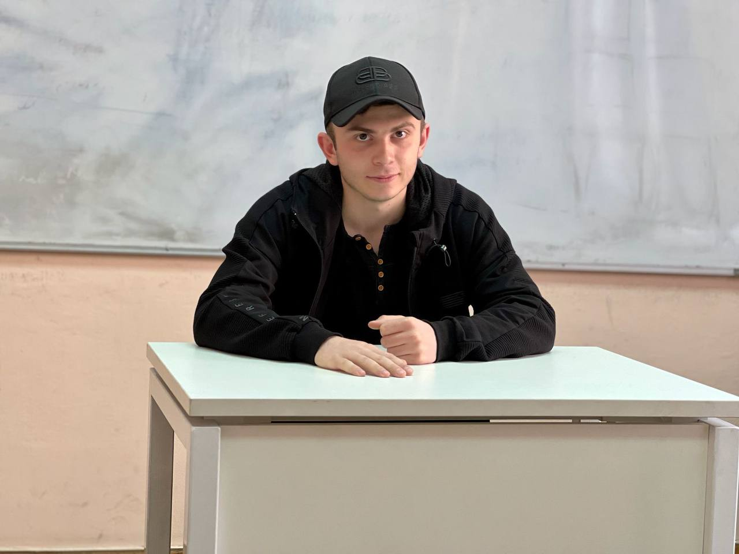

Our Team
Batyrbek Raiymbek
Begali Dinmukhammed
Kamalov Kamal
Creator and designer
Creator and web developer
Creator and mobile developer

Slide 4


Problem
Previously, as an educational business, we offered programming and English language courses, but faced the problem of a standardized approach that does not take into account the individual characteristics of students. As a startup, we see that there is a lack of truly personalized educational solutions on the market. Typical courses do not offer an individualized approach, which reduces students' interest and understanding, especially in such complex disciplines as programming and foreign languages.
1
Standard approach
Does not take into account the individual needs of students.
2
Lack of understanding
Students are unable to master difficult subjects.
3
Learning disabilities
Ineffectiveness of traditional online learning methods.

Slide 5


Solution
Dana-Bilim AI uses artificial intelligence to analyze each student's learning data and helps create an individualized educational path that takes into account their speed, aptitude, and knowledge gaps. This optimizes the learning process, improves student outcomes and reduces stress levels by adapting the pace of learning.
1
2
3
Data analysis
Program adaptation
Improving efficiency
AI analyzes each student's learning data.
Training is customized to meet individual needs.
Students learn at their own pace and achieve better results.

Slide 6
Technical Approach
Web-platform
Artificial Intelligence
HTML, CSS, JavaScript
Python
1
2
3
Mobile application
Swift

Slide 7
Canvas Business Model
Key Partners | Key Activities | Value Propositions |  | Customer Relationships | Customer Segments
Technical director, main investor, platform development team, potential investors, educational technology stakeholders. | Developing and maintaining the AI-powered platform, integrating video courses, testing with target audiences, and expanding the market. | Personalized learning in programming and English, adapting to individual student needs using AI. Offers continuous feedback, instant assistance, and automates routine tasks, which enhances learning outcomes and engagement. |  | Provides a self-guided experience with AI-based support, with mentor guidance available as needed. The platform creates a continuous feedback loop to track student progress and adapt to their needs. | Targeted at students in grades 5-11 in Kazakhstan, specifically those interested in programming and English who seek personalized and flexible learning experiences.
 | Key Resources |  |  | Channels
 | AI technology, high-quality educational content for programming and English, team expertise, website infrastructure, and access to target users for testing and feedback. |  |  | Website, partnerships with schools, digital marketing campaigns, and direct communication with students and parents via email, phone, and social media.
Cost Structure |  |  | Revenue Streams
Includes expenses for AI development, content creation, website maintenance, marketing, salaries, and platform updates. |  |  | Primarily generated from one-time course purchases with lifetime access, with potential for future premium content or service offerings to diversify revenue.

Slide 8
Business model and monetization
Model
Description
Basic
Access to core learning materials, one-on-one tutorials with mentors, full reporting and AI assistance, and supplemental materials. Limit on amount of requests
Model
Description
Advanced
Access to core learning materials, one-on-one tutorials with mentors, full reporting and AI assistance, and supplemental materials. No limit on amount of requests

Slide 9

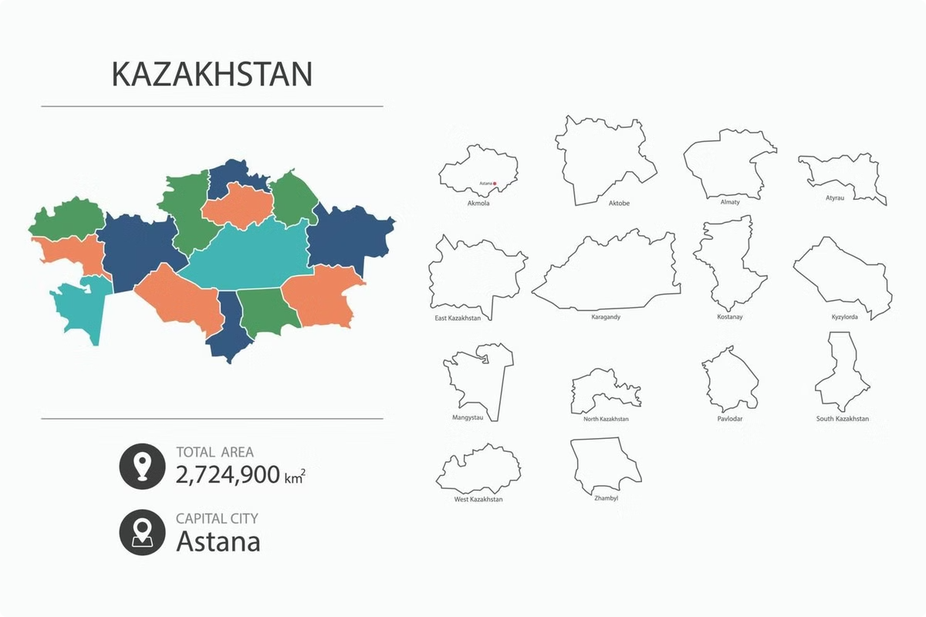



Market (TAM-SAM-SOM)
TAM: Education market in Kazakhstan. SAM: Pupils in grades 5-11 interested in IT and English. SOM: Students ready to use online resources for learning.
TAM
Educational market of Kazakhstan.
380 milliard tenge
SAM
Students in grades 5-11 who are interested in IT and English.
38 milliard tenge
SOM
Students who are ready to use online resources for learning.
380 million tenge

Slide 10
Competitors and competitive advantage
The main criteria
Dana-Bilim AI
Local courses (GeekBrains, SkillBox etc.)
Coddy.kz
Coursera
Personalized learning
(AI)
✅
❌
❌
❌
Focus on 5-11 grades
✅
❌
❌
❌
Programming
learning
✅
✅
✅
✅
English
learning
✅
✅
❌
✅
Instant help (without a supervisor)
✅
❌
❌
❌
Accessibility for
Kazakhstan
✅
✅
✅
✅

Slide 11
Tracking and current status
1
2024 august
Project foundation date: The idea and launch of a project to teach programming and English to students in grades 5-11.
2
2024 october
Development of the first version of the platform: Creation of basic functionality for courses.
Sale: The beginning of the first sales of courses, which allowed us to confirm the interest of the target audience.
3
2024 december
Completion of video tutorial integration: Technical improvements are almost complete, including video content.
Platform testing: Conducting testing among the target audience (students in grades 5-11) on the current version without AI.
Launching the current version of the platform: Starting work on monetization of courses to create a student base.
The next step is the introduction of AI: After data collection and successful testing, it is planned to introduce AI to personalize training.

Slide 12



Growth and investment potential
International expansion
1
Transition from Kazakhstan to other countries
2
Adaptation of courses
Content development for schoolchildren, students and professionals
3
Education market
IT and programming are in-demand fields of study
Dana-Bilim AI is a revolutionary educational platform with the potential to scale. Starting from Kazakhstan, we plan to enter the international market, adapting training programs for different groups of users. Investing in E-learning is an investment in the future, where our platform can become a leader in online education.

Slide 13
Contacts
For more information or to start a cooperation, please contact us. Here are our contact details for easy communication:
Website
Email
Phone Number
danabilimAi
batyrbek.2005@bk.ru
+7 771 585 78 43
Telegram
@raiym08
We are open to your suggestions and ready to discuss possible ways of cooperation and investment. Don't hesitate to get in touch!

